Slide 1
Trust and Kerberos
Network Security
Spring 2018
Lecture Notes

Slide 2
Weakness of TLS
TLS is worthless without trust
If you go to https://yourbank.com, it better be “your bank”
How do you know it is your bank?

Slide 3
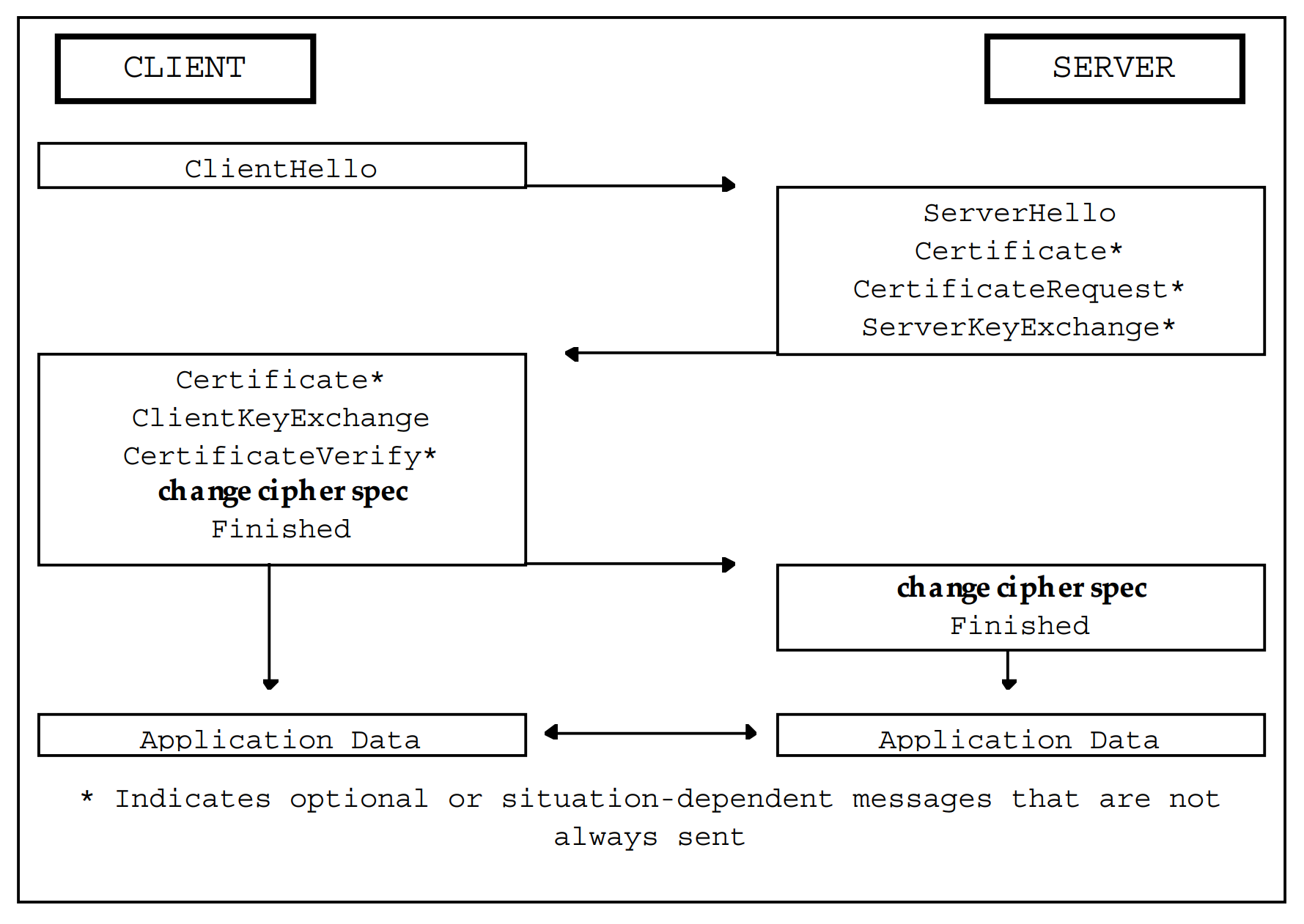
Review TLS Hanshaks

Slide 4
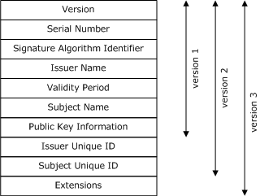
What is a Certificate?
TLS specification (RFC) doesn’t specify cert or cert verification
The most common is X 509

Slide 5
Key Elements
Identifying Data
Names
Serial Number
Chain Data
Who signed the certificate
Public key
Signature

Slide 6


Public Key Private Key
Name: yourbank
Issuer: godaddy
**signature**
PUBLIC KEY
PRIVATE KEY

Slide 7
Proving Identity
Who are you?
CERT
I’m yourbank
VERIFY CERT:
- sbj = yourbank?
- chain trusted?
Ok, prove it (nonce)
{nonce}private_key
PUBLIC KEY
PRIVATE KEY

Slide 8
Chain of Trust
CERT
Name: godaddy
Signed by godaddy
Godaddy public
key verifies cert
CERT
Banking assoc public
key verifies cert
Name: banking_association
Signed by godaddy
CERT
Name: Yourbank.com
Signed by banking_association
Yourbank public
key verifies signature
on nonce

Slide 9
Root Cert
The Root certificate is self signed
It is signed by its own key!
You have to “trust” somebody axiomatically!

Slide 10
Cert Chain Verification (Inputs)
The certificate chain
The current date/time
Policy information
Root certificates

Slide 11
Cert Chain Verification (Algorithm)
PKI parameters/algorithms
Validity of the certificate (time/expiration)
Revocation status (OCSP, CRL, etc)
Issuer name matches next subject in path
Policy checks
Any intermediate certs are CA CERTS!

Slide 12
Checking CA Certs
A CA (Certificate Authority) cert should be marked
Otherwise, you can do this:
ROOT
Signs, intermediate CA
Signs subject (e.g., “yourbank.com”) USED AS CA!!!!
Signs fake subject (e.g., “wrongbank.com”)

Slide 13
Certificate Revocation
How do you revoke a certificate?
Difficult: so long as the cert is properly signed, it is believed
You can publish certificate revocation lists:
Uses just serial number
So make sure your serial numbers are actually unique!
But, until the new CRL is received, bad cert still usable

Slide 14
Online Certificate Status Protocol (OCSP)
Certificates were designed to be used offline
However, modern security constraints often necessitate OCSP
Client can ask a server (‘OCSP Responder’) about a cert
Server can respond “Good”, “Revoked”, “Unknown”
Response is signed; however, vulnerable to replay attacks!
An extension permits nonces, but often not used for efficiency
Also, potential privacy losss
But, more efficient and timely than CRL

Slide 15
Other Alternatives to TruST?
Sadly, there is no known way to create trust out of thin air
In almost every case, there must be a trust basis:
Out-of-band communication (e.g., in real life)
Evolutionary trust over time with long-term identifiers
Third parties, including CA’s, authentication/reputation servers
Crowds, such as distributed ledger

Slide 16
Kerberos
Kerberos vs TLS
Kerberos uses a trusted authentication server
Must be online. And, if compromised, entire system compromised
Provides mutual authentication, confidentiality, etc
Basic components:
Authentication Server
Key Distribution Server (KDS)
Ticket Granting Service
Service Server

Slide 17
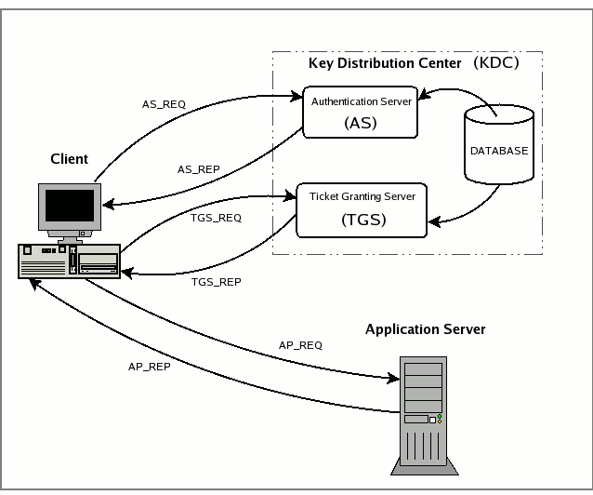
Kerberos communication

Slide 18
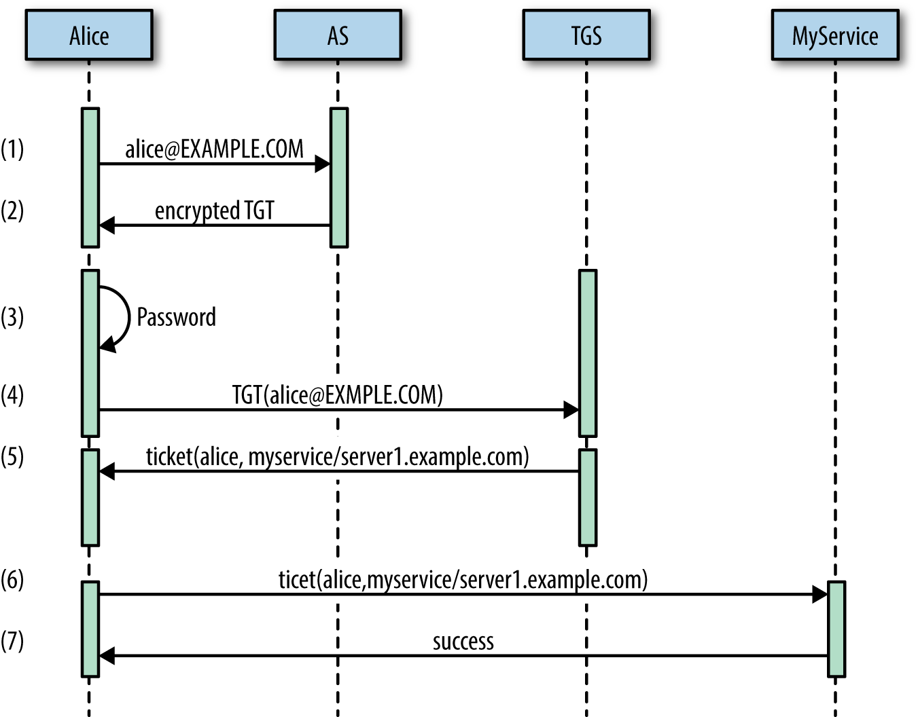
Kerberos Protocol

Slide 19
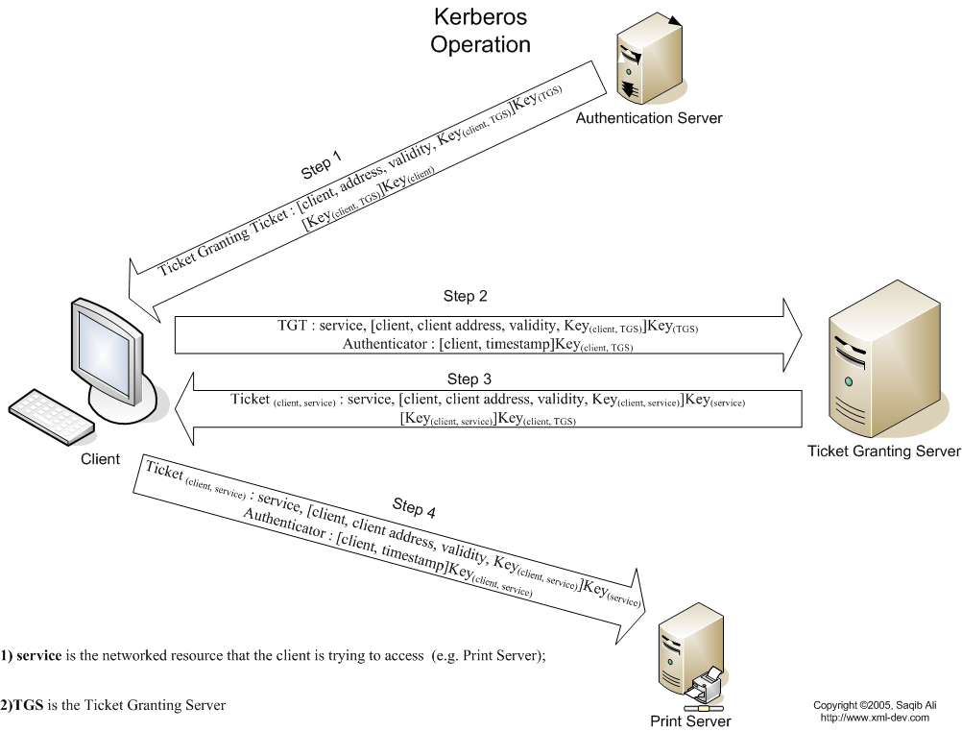
Kerberos Protocol x2

Slide 20
Protocol Principles
Note that the user’s key never goes over the wire
Note that pre-encrypted messages can be sent.
AS sends a message to A that only TGT can decrypt
Thus, TGT knows that the message sent by A MUST come from AS
How scalable is this system?

